Slide 1
PAL Session 4

Slide 2
What are we doing today?
Today the session is focused on programming.
We can either do SRPN or Abstract Data Types.
For SRPN, you can spend the whole session programming on SRPN and we can go around helping, much like last week.
Or, we can quickly look at Complex & Abstract Datatypes, and then try some practice questions on relit. :
Arrays
Lists, Tuples, Sets & Dictionaries in Python

Slide 3
Complex Datatypes - Python
Usually a composite of other existing data types.
This includes an array, a dictionary etc.
To the right, we can see some complex data types in python:
Lists | Tuples | Sets
A collection of objects, which can be integers, strings, floats etc aList = [2,”5”, 6, “seven”] numberList = [1,2,3,4] This is ordered and changeable, allowing duplicate items. | Tuples are ordered collections of values of different types and are unchangeable. This means we cannot change, add or remove items from the tuple once it has been created. myTuple = (2,3,4) tuple2 = (34, True, “female”) | An unordered, unchangeable collection, with no duplicates. mySet = {1,2, “Coding is Fun”}

Slide 4
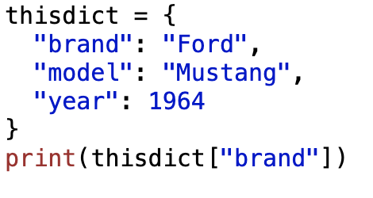
Dictionaries - Python
Python also contains dictionaries, an unordered (depending on Python version. Earlier versions are unordered, ordered as of 3.7), changeable and indexed collection.
Not allowed duplicates.
Dictionary items are presented in key:value pairs, and we can find a certain value from using the key.

Slide 5
Abstract Data Types
So, each of these types is essentially a collection of data, in slightly different ways.
We also have functions that are specific to each of the types.
This combination of data representation and functions = Abstract Data Type.

Slide 6
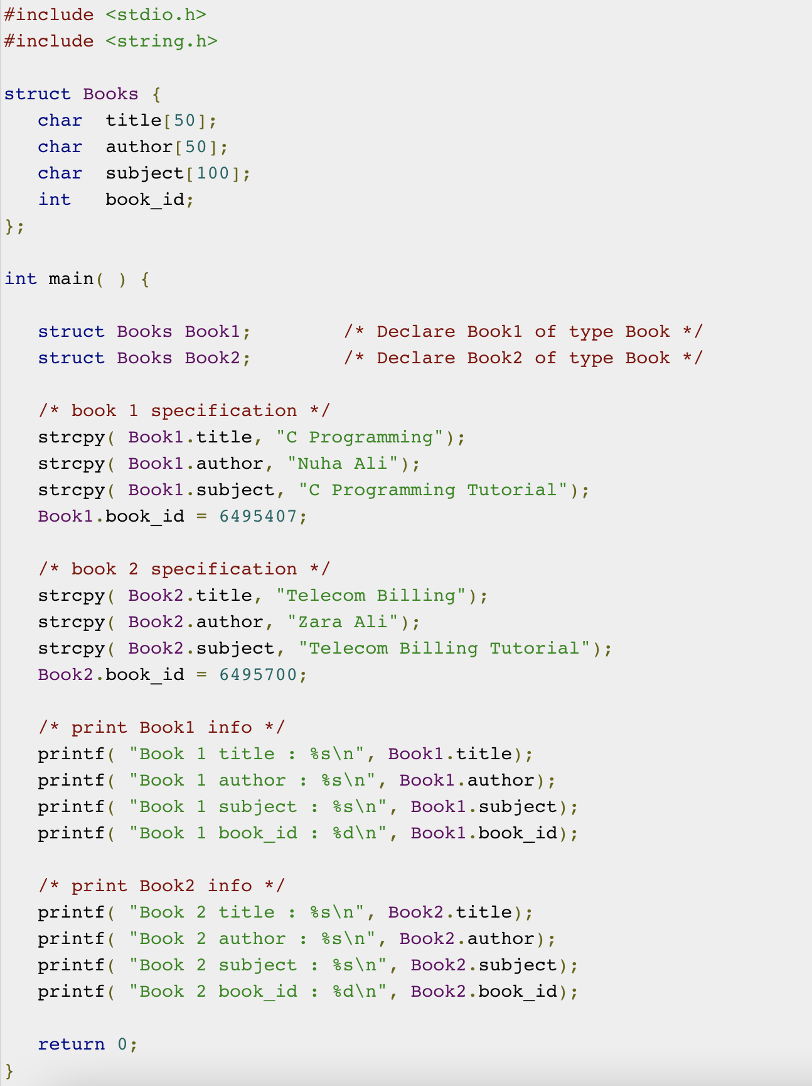
Creating ADTs in C
Extra:
Note the use of strcpy for the the value of author and title.
https://stackoverflow.com/questions/3131319/how-can-i-correctly-assign-a-new-string-value

Slide 7
Python Programming Exercises
Lists :
Write a program to sum all the items in a list.
Write a program to get the largest number from a list.
Write a program to remove duplicates from a list, returning a list as the output.
Write a program to join adjacent members of a given list, assume the list will always be of even length.
Write a program to sort a list of integers from smallest to highest, without using the sort() function ☺
Tuples:
1. Write a program to turn a tuple of strings to a tuple of integers. Assume the strings can be converted to integers

Slide 8
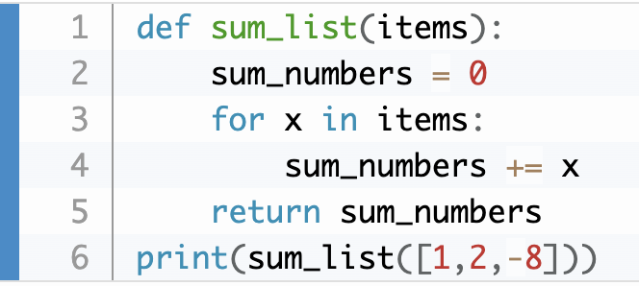
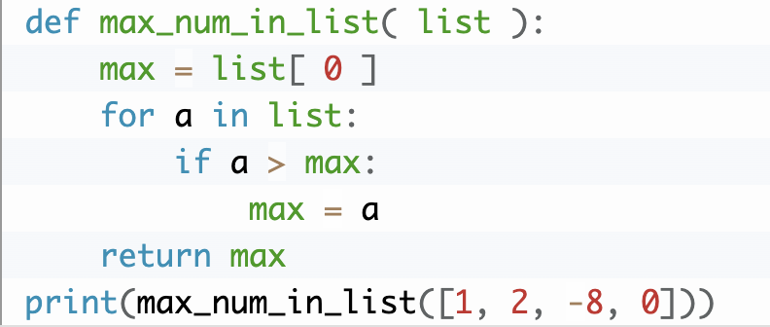
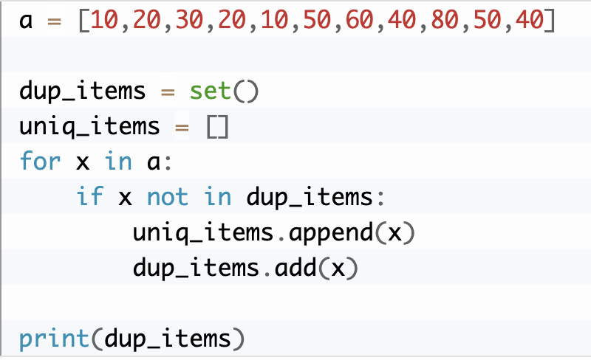
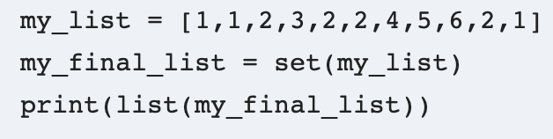
Lists
Perhaps a better way:

Slide 9
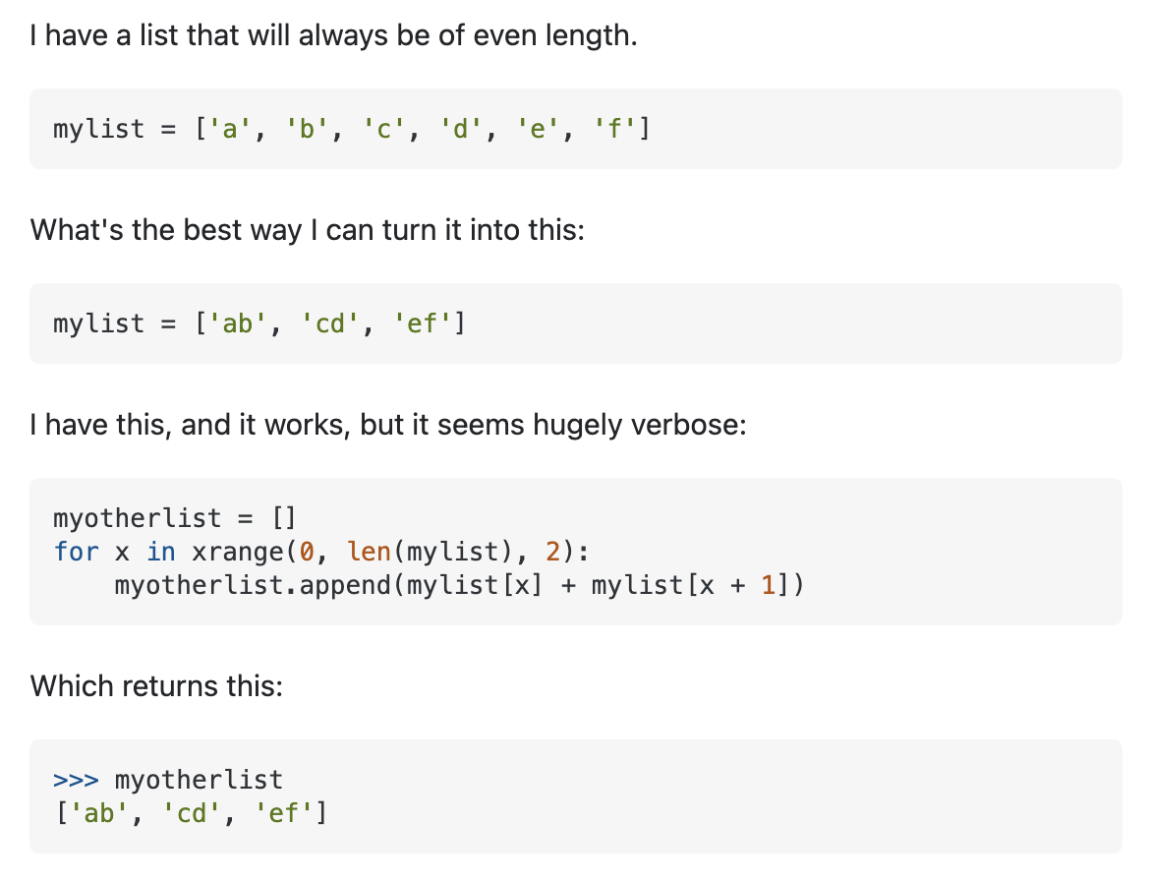
Lists – Q4
A few ways, some using list comprehension, some using a for loop.
https://stackoverflow.com/questions/23012425/python-joining-adjacent-members-of-a-list

Slide 10
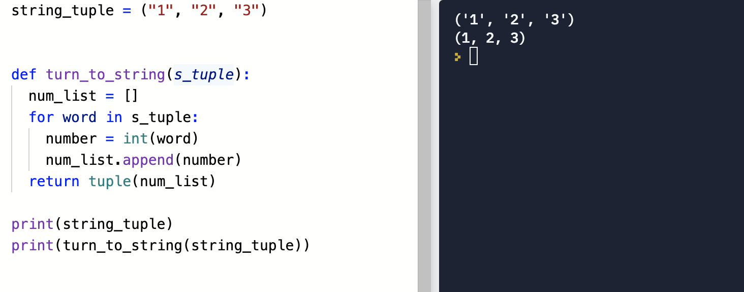

Slide 11
Want to practice Python?
https://www.w3resource.com/python-exercises/

